Slide 1


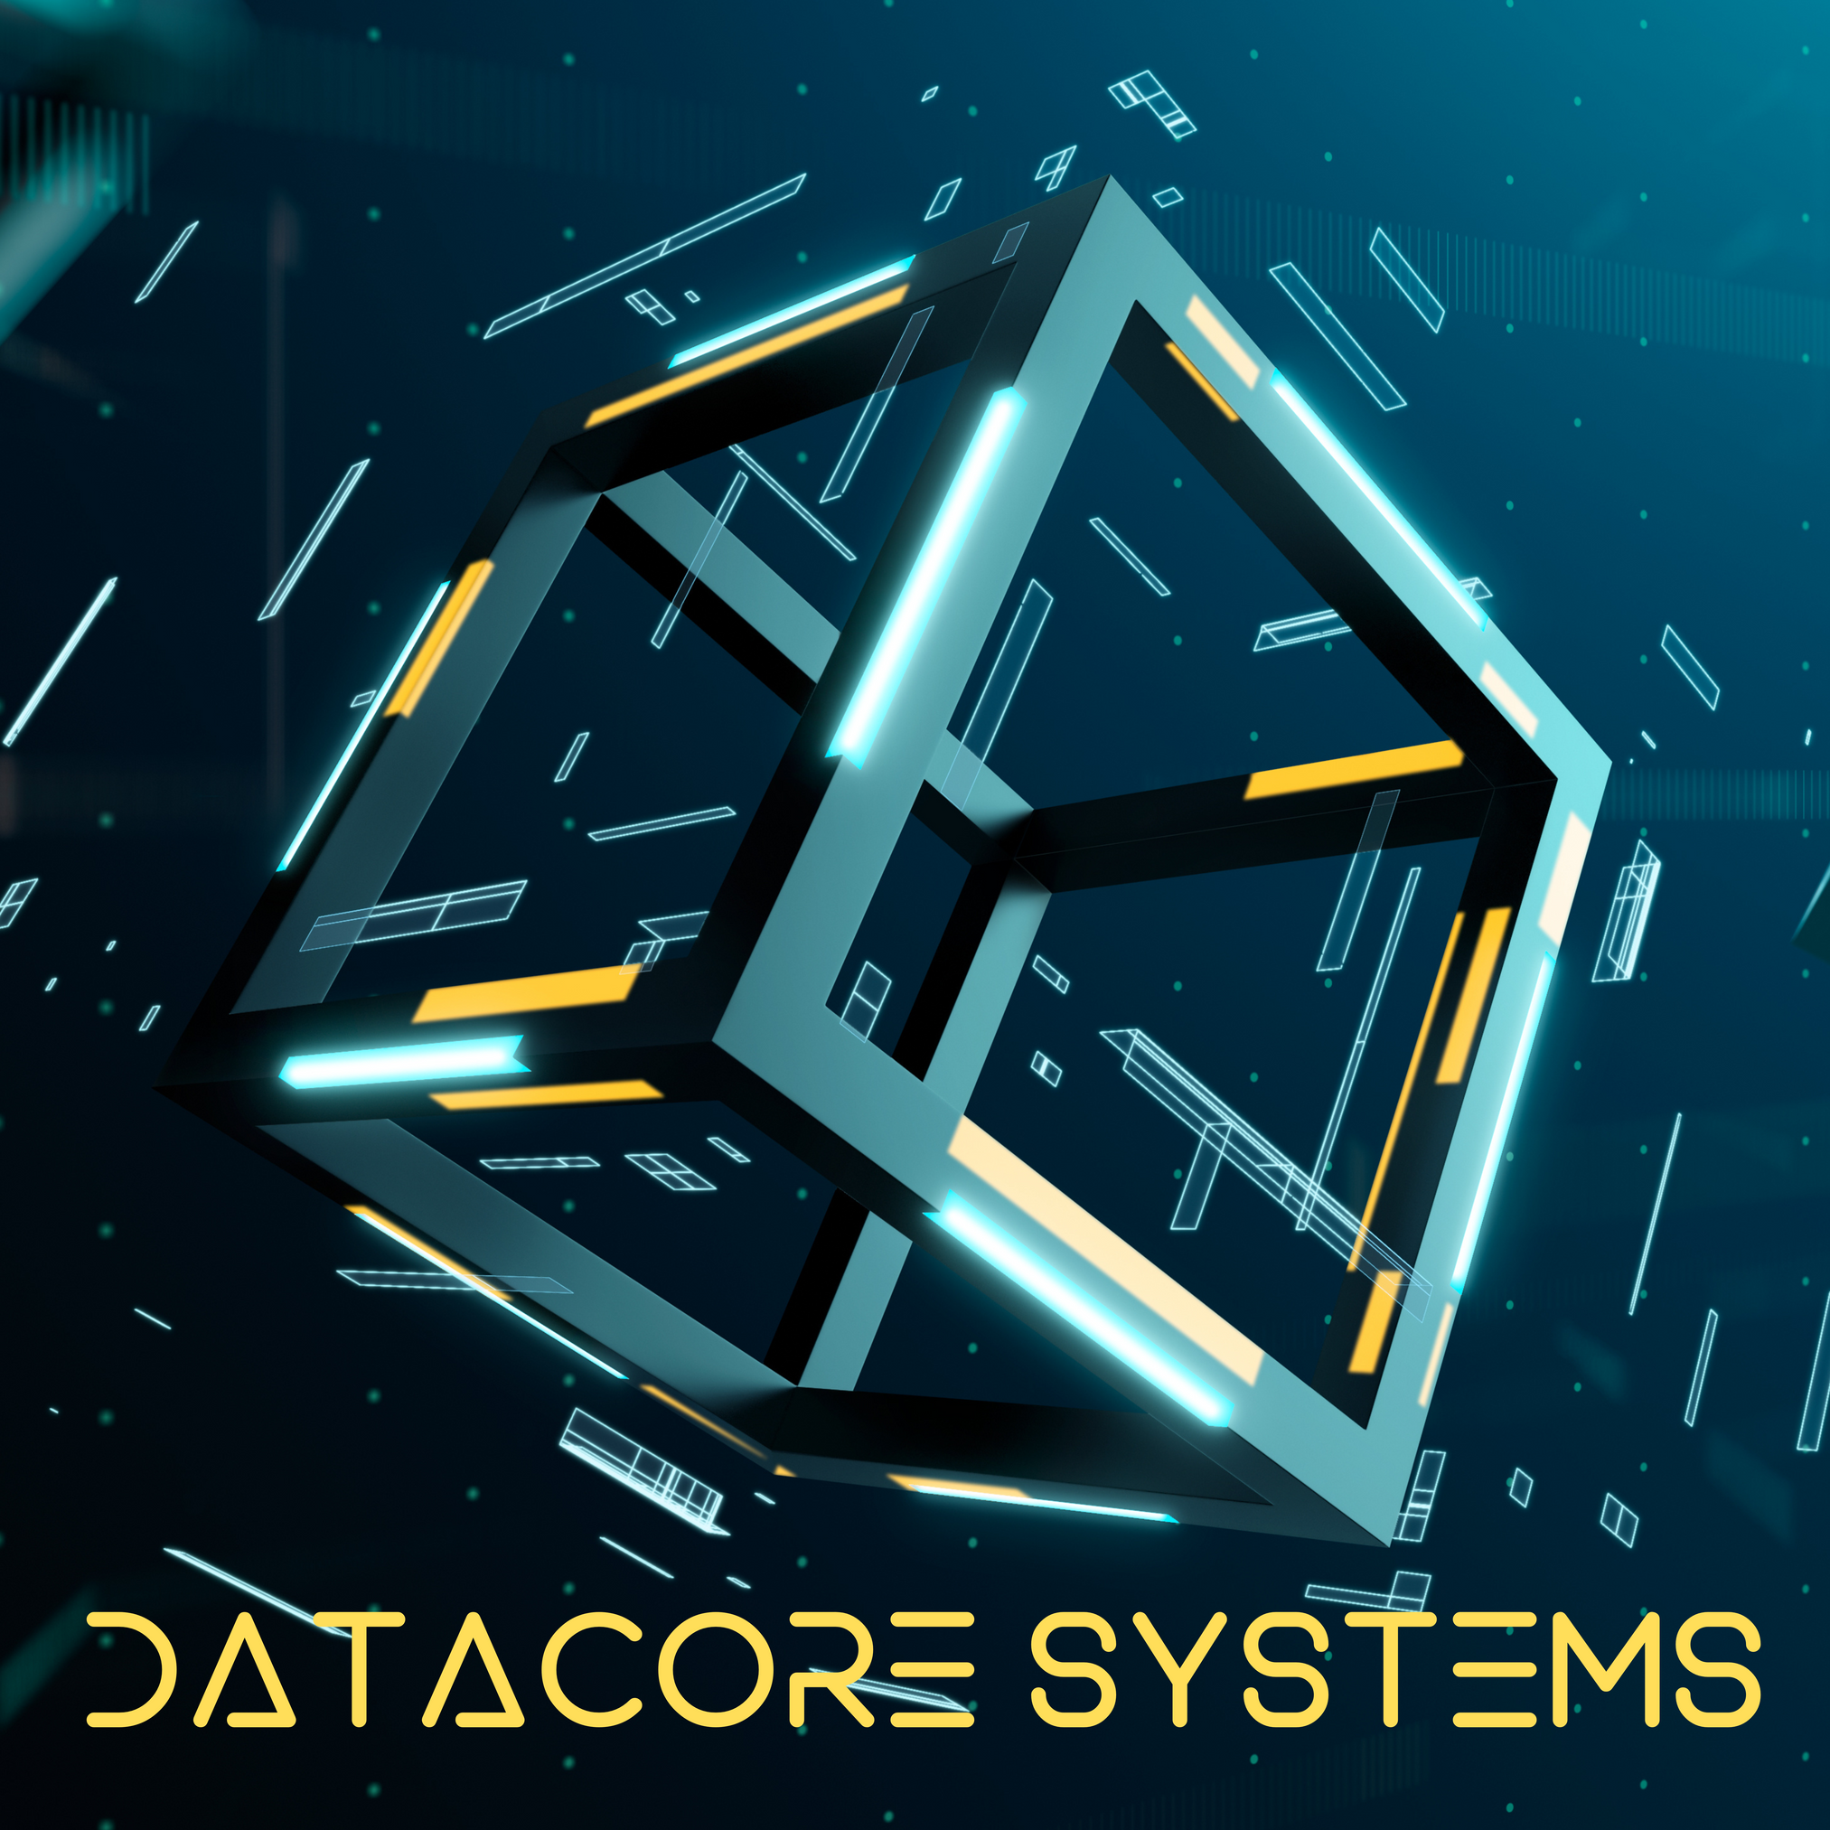

Founded By:
Umer
Hussain
Muhammad

Slide 2



DataCore Systems
Shape Of You App
UI: JAVAFX

Slide 3


Slide 4
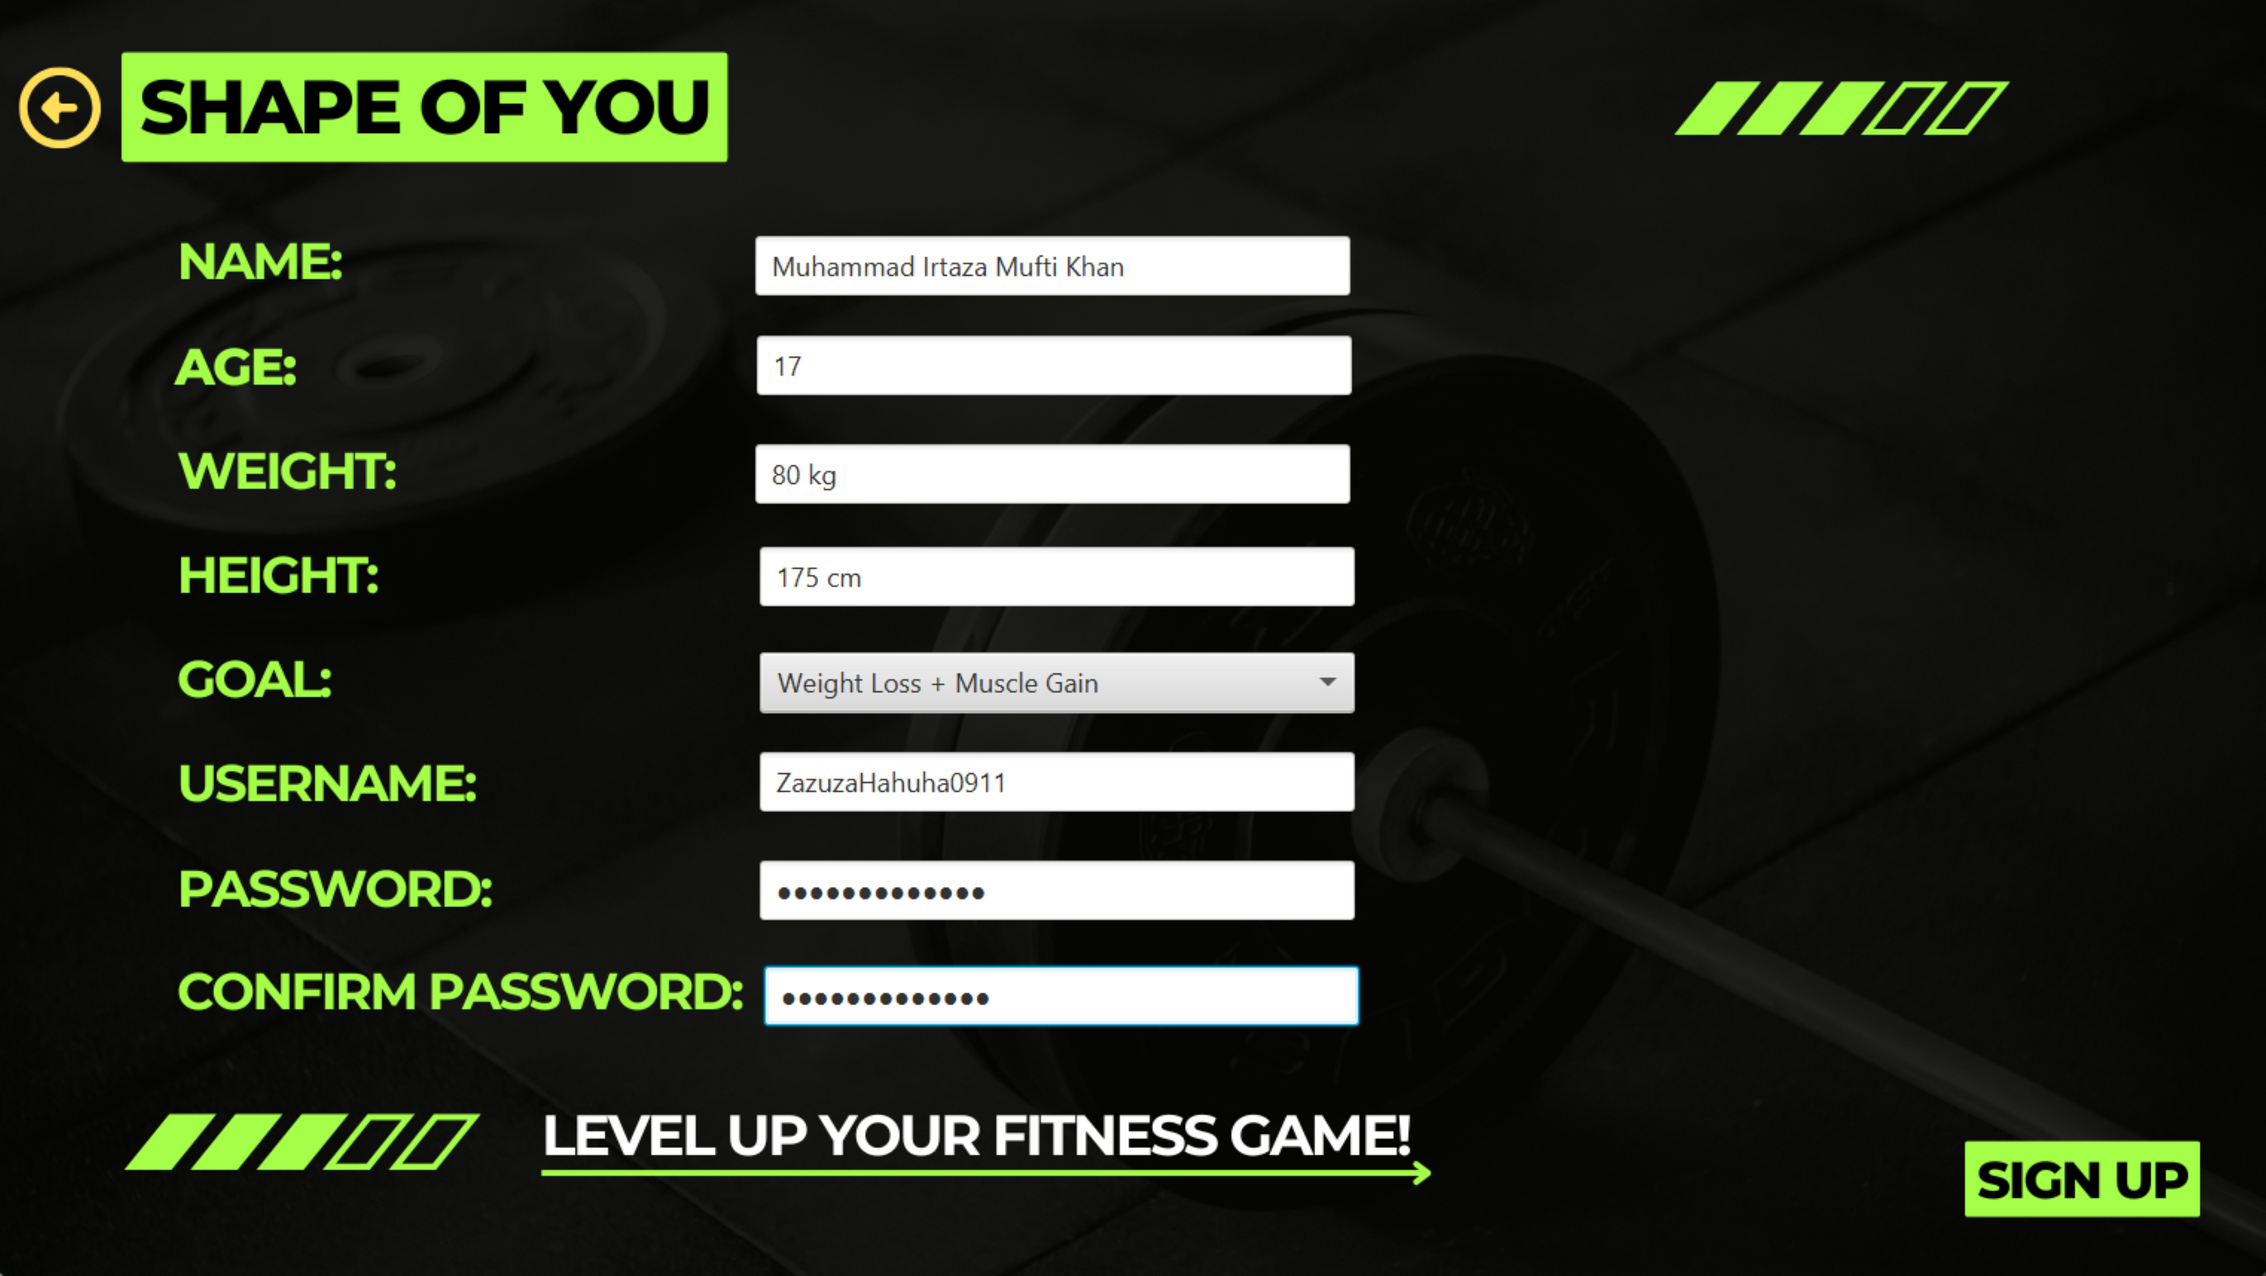

Slide 5
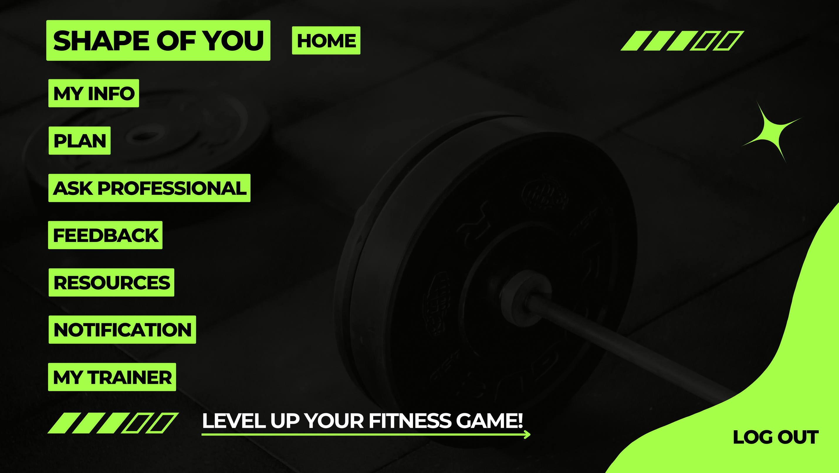
USER HOME

Slide 6
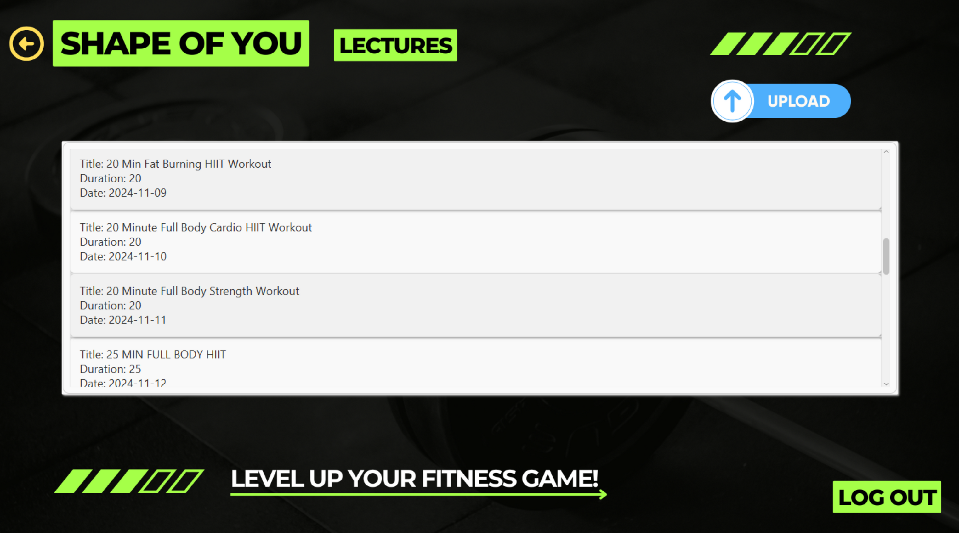

Slide 7
DataCore Systems
Shape Of You App
MOST COMPLEX USECASE

Slide 8
DataCore Systems
Shape Of You App
GENERATE PERSONALIZED DIET PLAN

Slide 9
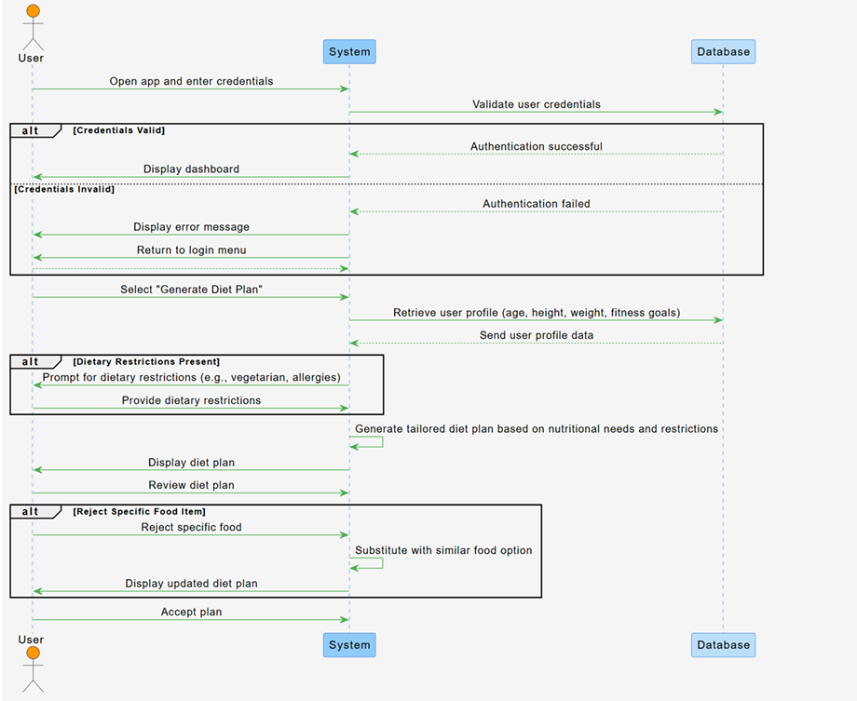
DataCore Systems
Shape Of You App
SEQUENCE DIAGRAM

Slide 10
DataCore Systems
Shape Of You App
DBMS: MS SQL SERVER
CONNECTION: JDBC

Slide 11


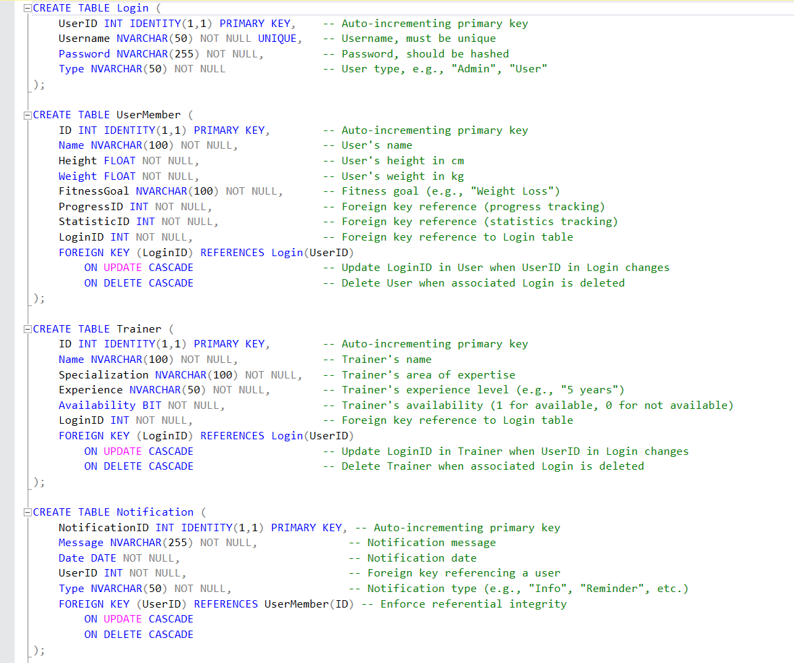
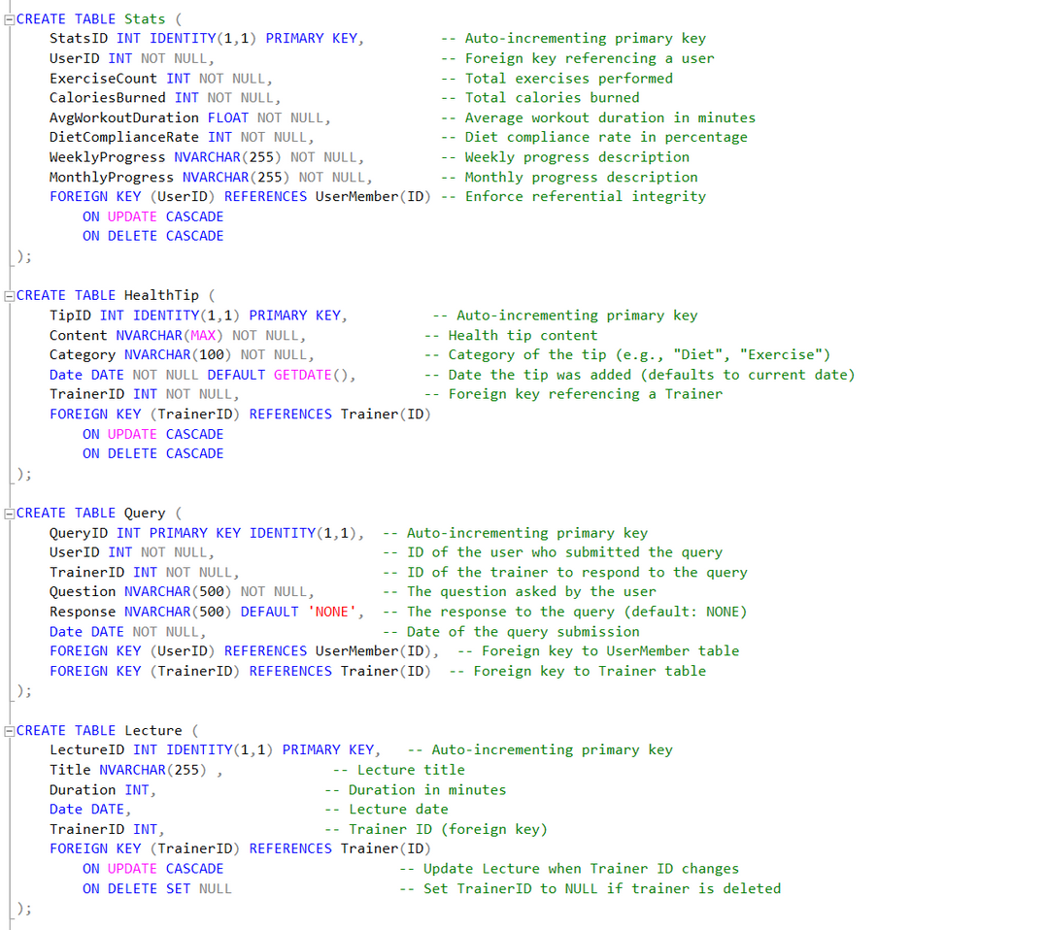

SQL DATABASE

Slide 12
DESIGN PRINCIPLES AND STRATEGIES
DESIGN PRINCIPLES:
SINGLE RESPONSIBILITY PRINCIPLE (SRP)
LOW COUPLING
HIGH COHESION
PROTECTED VARIATIONS
SINGLETON (GOF)
GRASP PATTERNS:
CREATOR
INFORMATION EXPERT
CONTROLLERS AND HANDLERS

Slide 13
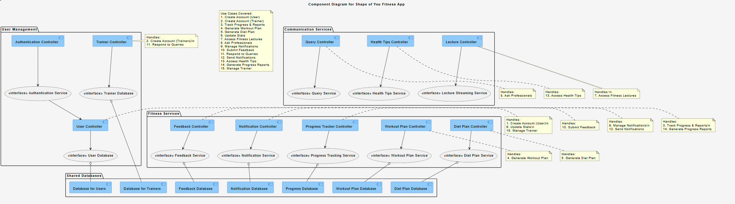
DataCore Systems
Shape Of You App
SYSTEM COMPONENT DIAGRAM

